Slide 1
State of the Art NLP Using Deep Learning

Slide 2
State-of-the-art Work
Significant progress has been made in the field of natural language processing (NLP) in the 2-3 recent years.
We next review four high-impact studies:
ELMo
The Transformer (tensor2tensor)
OpenAI GPT
BERT

Slide 3
ELMo
ELMO (Embedding from Learning Models) generates contextualized word embeddings that can then be used in other tasks (i.e., transfer learning).
ELMo takes into account not only the token itself, but its context.
Can be highly useful in cases such as:
He kicked the bucket.
I have yet to cross-off all the items on my bucket list.
The bucket was filled with water.

Slide 4
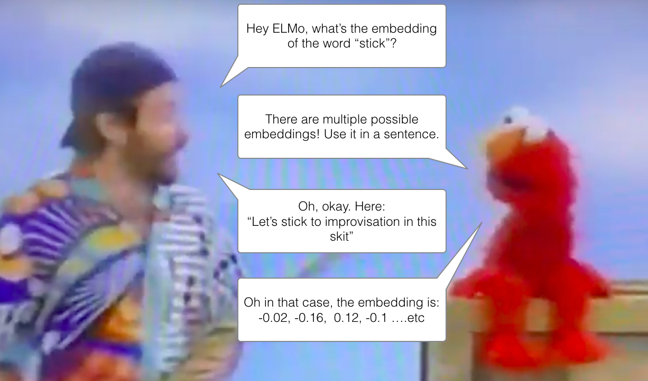

Slide 5
ELMo
The basic idea:
Use bi-directional language models (biLMs) to predict the next/previous word in a sentence
Concat the output into two feedforward layers
Use a softmax to output the final probability
Prior to the biLM:
Use character-based embedding (identifies partial matches and supports stemming-like operation)
Apply n-gram character convolution filters (2048 filters in the original paper)
Feed the output into two highway layers
This probability can be used as input in a multitude of other tasks, improving their performance
Experiments show that it can be effective both at the input and output of an RNN
Depends on the task at hand

Slide 6
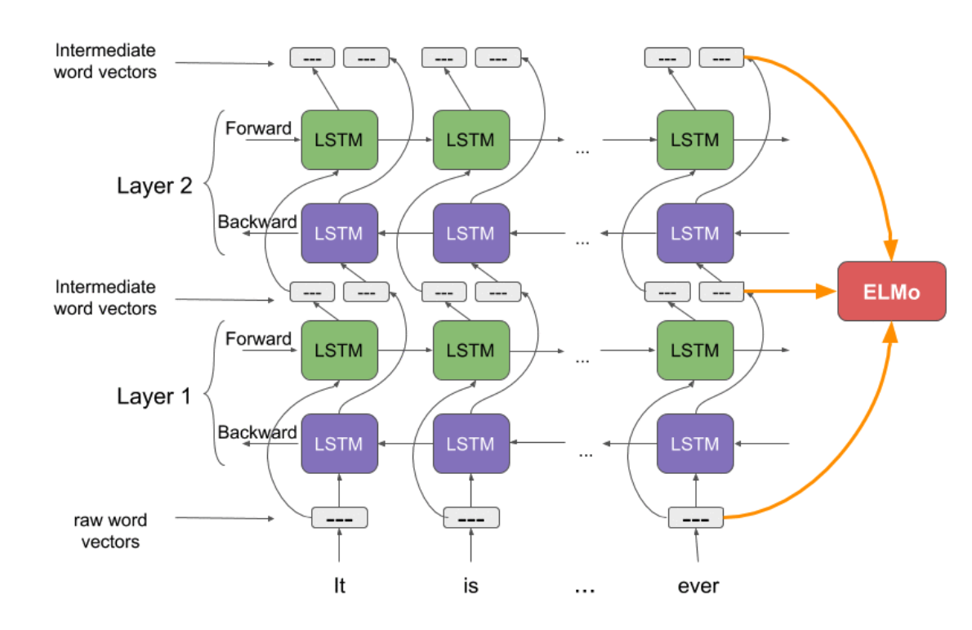
ELMo

Slide 7
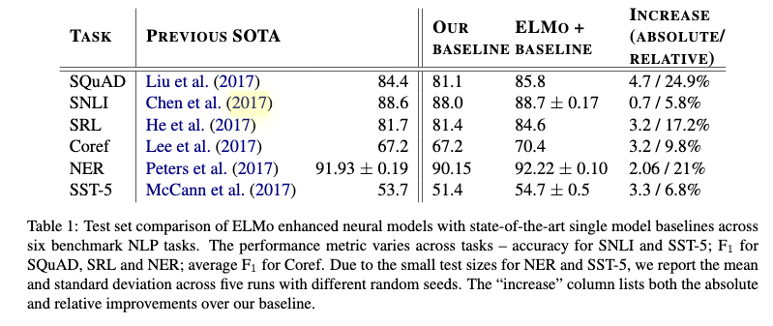
ELMo – Results

Slide 8
State-of-the-art Work
Significant progress has been made in the field of natural language processing (NLP) in the 2-3 recent years.
We next review four high-impact studies:
ELMo
The Transformer (tensor2tensor)
OpenAI GPT
BERT

Slide 9
The Transformer Architecture
Despite their effectiveness, RNNs have several limitations:
They are slow
Long-term dependencies are still difficult
A famous quote from ACL 2014: “You can’t cram the meaning of a whole %&!$# sentence into a single $&!#* vector!”
The main idea: abandon RNNs altogether, use advanced attention mechanisms instead
That why the paper is called “Attention is all you need”
Notes:
The problem with an autoencoder is that we would like to be able to represent the different positions in the text, and when the encoder compresses everything to a single vector, this becomes much more difficult.

Slide 10
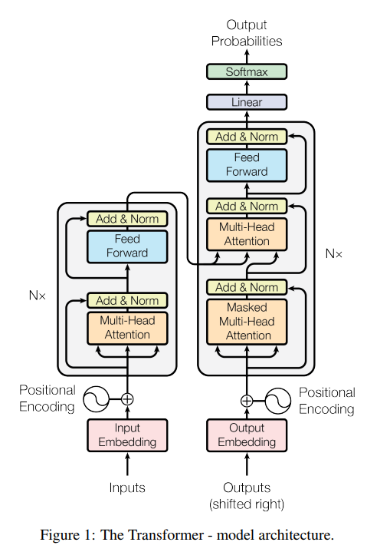
The Transformer Architecture
Consists of multiple novel elements:
Scaled Dot-Product Attention
Multi-Head Attention
Position-wise Feed-Forward Networks
Embeddings and Softmax
Positional Encoding
Vaswani, Ashish, et al. "Attention is all you need." Advances in Neural Information Processing Systems. 2017.

Slide 11
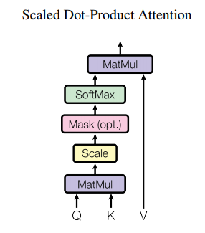
Scaled Dot-Product Attention
The input consists of queries, keys and values
In “standard” attention-based RNNs
Keys – the encoder hidden state
Query – the decoder hidden state
Values – the relevance of the encoder hidden states (i.e., attention weights), calculated based on the keys and queries
Both in attention-based RNNs and the Transformer, the weight assigned to the value is based on the compatibility between the query and key

Slide 12
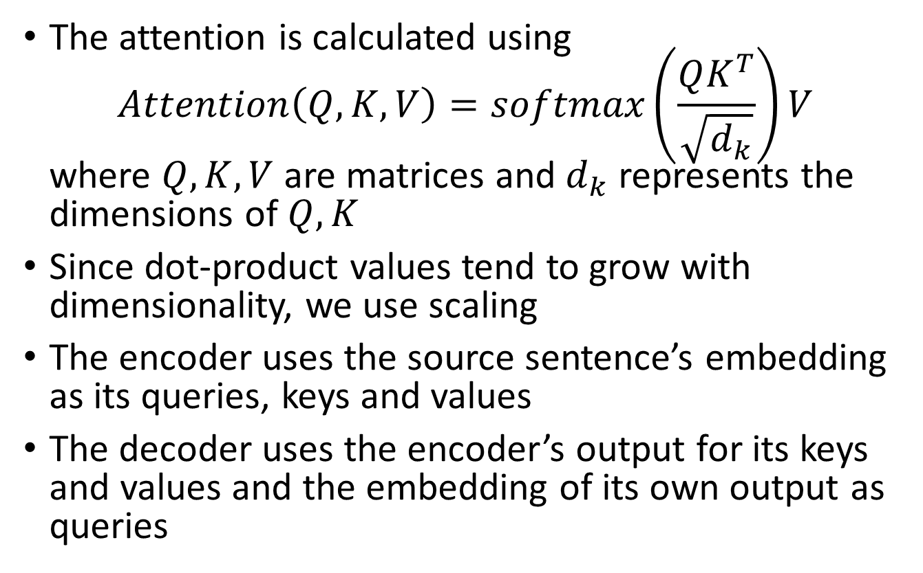
Scaled Dot-Product Attention
The attention is calculated using $Attention\left(Q,K,V\right)=softmax\left(\frac{QK^{T}}{\sqrt{d_{k}}}\right)V$ where $Q,K,V$ are matrices and $d_{k}$ represents the dimensions of $Q,K$
Since dot-product values tend to grow with dimensionality, we use scaling
The encoder uses the source sentence’s embedding as its queries, keys and values
The decoder uses the encoder’s output for its keys and values and the embedding of its own output as queries
Notes:
It is important to note that both the encoder and the decoder have multiple layers, so the statement above is correct for the first layer. Subsequent layers receive as input the output of their predecessors

Slide 13
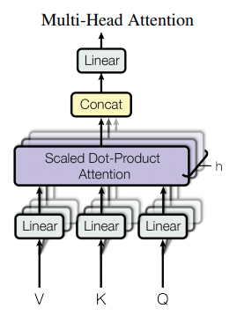
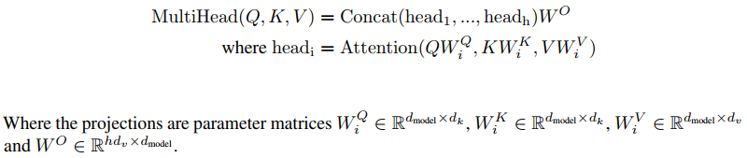
Multi-Head Attention
Using a single attention mechanism would make it difficult to model multiple dependencies in the text
For this reason we use multiple attention heads
A different linear transformation is applied for each attention head. The output is then concatenated and rescaled
The total computational cost is similar to that of single-head attention with full dimensionality.

Slide 14
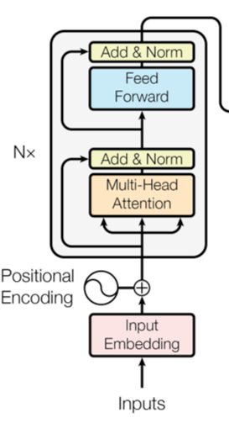
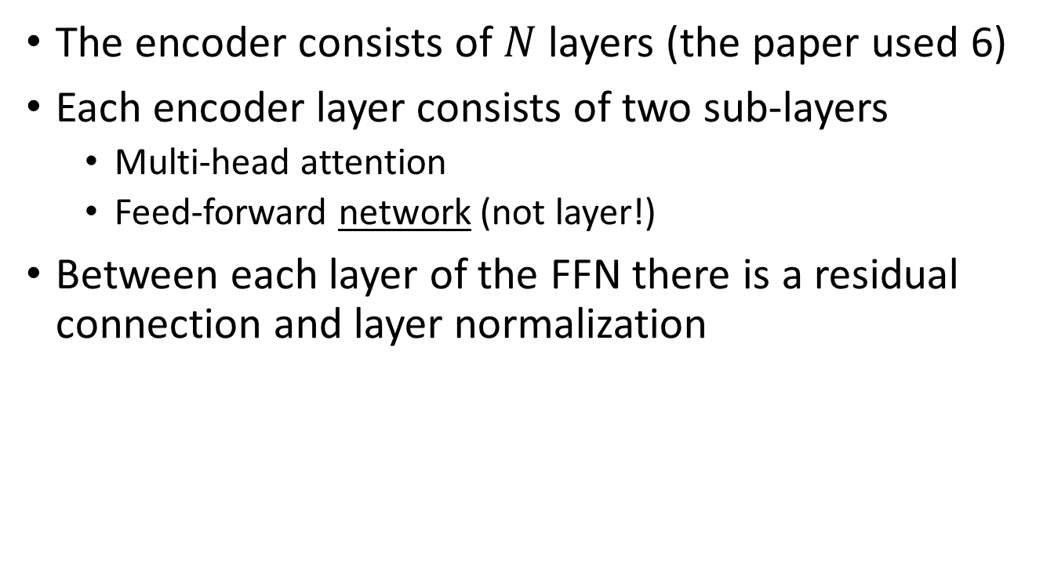
The Encoder
The encoder consists of $N$ layers (the paper used 6)
Each encoder layer consists of two sub-layers
Multi-head attention
Feed-forward network (not layer!)
Between each layer of the FFN there is a residual connection and layer normalization
Notes:
Layer normalization is a technique similar to batch normalization.

Slide 15
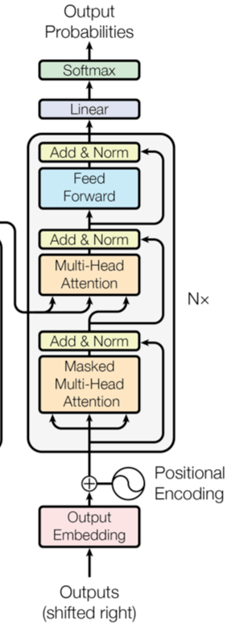
The Decoder
Similar to the encoder, but we use masked attention heads so that we don’t see future inputs

Slide 16
Tying the Embeddings and the Softmax
The authors use the same embedding weights for the input and output embeddings
Shown to improve performance and reduce training time
Notes:
See work in https://arxiv.org/pdf/1608.05859.pdf

Slide 17
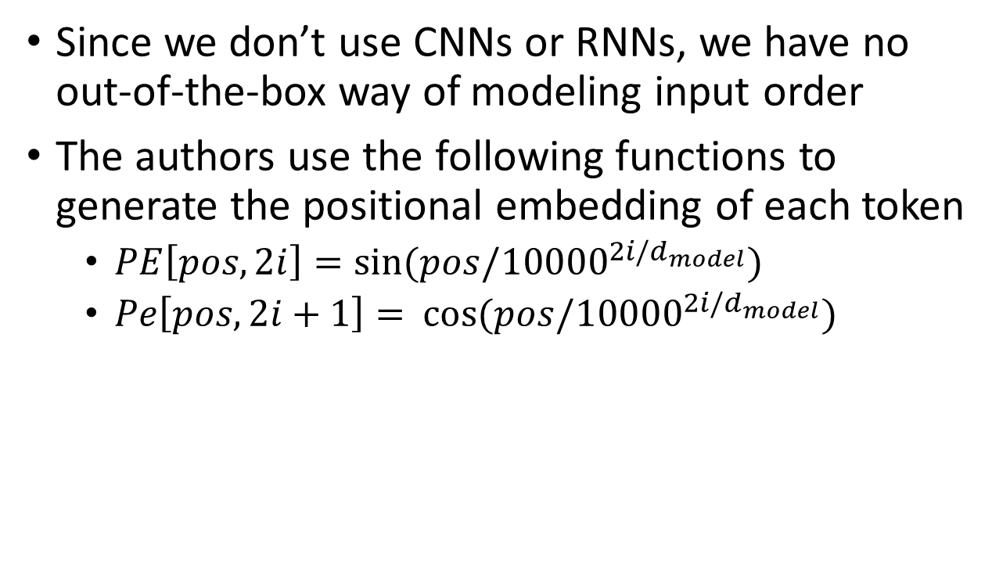
Positional Encoding
Since we don’t use CNNs or RNNs, we have no out-of-the-box way of modeling input order
The authors use the following functions to generate the positional embedding of each token
$PE\left[pos,2i\right]=\sin{(pos/{10000}^{2i/d_{model}})}$
$Pe\left[pos,2i+1\right]=⁡\cos{(pos/{10000}^{2i/d_{model}})}$
Notes:
Dmodel has the same dimensionality as the embedding so that the two can be summed up easily

Slide 18
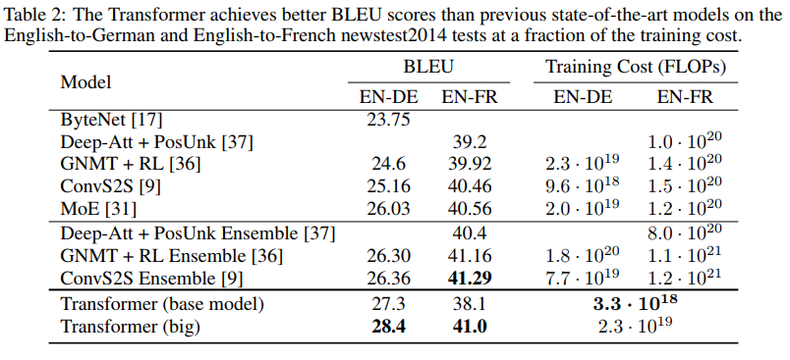
Transformer - Results
English-to-German translation: a new state-of-the-art (increase over 2 BLEU)
English-to-French translation: a new single-model state-of-the-art (BLEU score of 41.0)
Less training cost

Slide 19
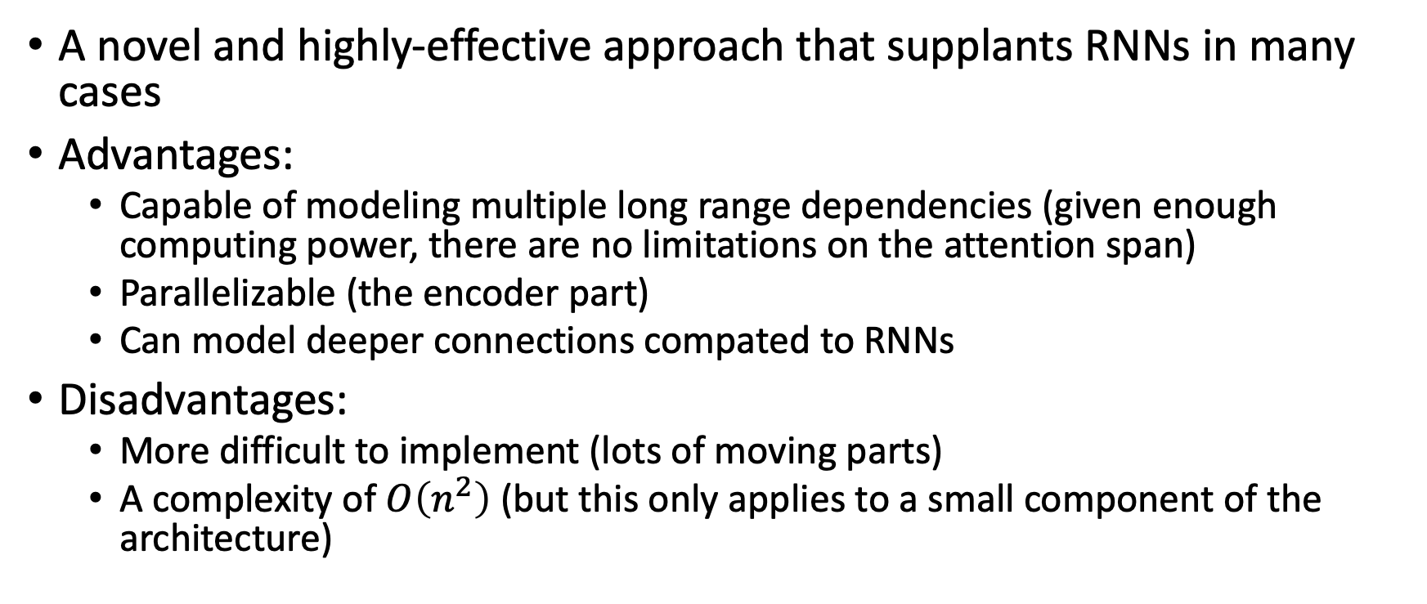
Transformers: Summary
A novel and highly-effective approach that supplants RNNs in many cases
Advantages:
Capable of modeling multiple long range dependencies (given enough computing power, there are no limitations on the attention span)
Parallelizable (the encoder part)
Can model deeper connections compated to RNNs
Disadvantages:
More difficult to implement (lots of moving parts)
A complexity of $O\left(n^{2}\right)$ (but this only applies to a small component of the architecture)

Slide 20
State-of-the-art Work
Significant progress has been made in the field of natural language processing (NLP) in the 2-3 recent years.
We next review four high-impact studies:
ELMo
The Transformer (tensor2tensor)
OpenAI GPT
BERT

Slide 21
Generative Pre-Training
The challenge: while very large corpora of unlabeled text are available, labeled texts are often in short supply
The proposed approach: apply a two-step process of learning from large unlabeled corpora and then fine-tune the model for the supervised learning problem
The approach set new state-of-the-art standards in 9 out of the 12 tasks that were evaluated
This approach has one significant advantage over BERT (which we learn next):
It is one-directional, and therefore can be used to generate new content
Notes:
This approach is commonly known as transfer learning. It is also very common in the field of reinforcement learning, where available data is often sparse and hard to generate.

Slide 22
Example: Text Generation
Human input: In a shocking finding, scientist discovered a herd of unicorns living in a remote, previously unexplored valley, in the Andes Mountains. Even more surprising to the researchers was the fact that the unicorns spoke perfect English.
GPT output:
The scientist named the population, after their distinctive horn, Ovid’s Unicorn. These four-horned, silver-white unicorns were previously unknown to science.
Now, after almost two centuries, the mystery of what sparked this odd phenomenon is finally solved.
Dr. Jorge Pérez, an evolutionary biologist from the University of La Paz, and several companions, were exploring the Andes Mountains when they found a small valley, with no other animals or humans. Pérez noticed that the valley had what appeared to be a natural fountain, surrounded by two peaks of rock and silver snow.

Slide 23
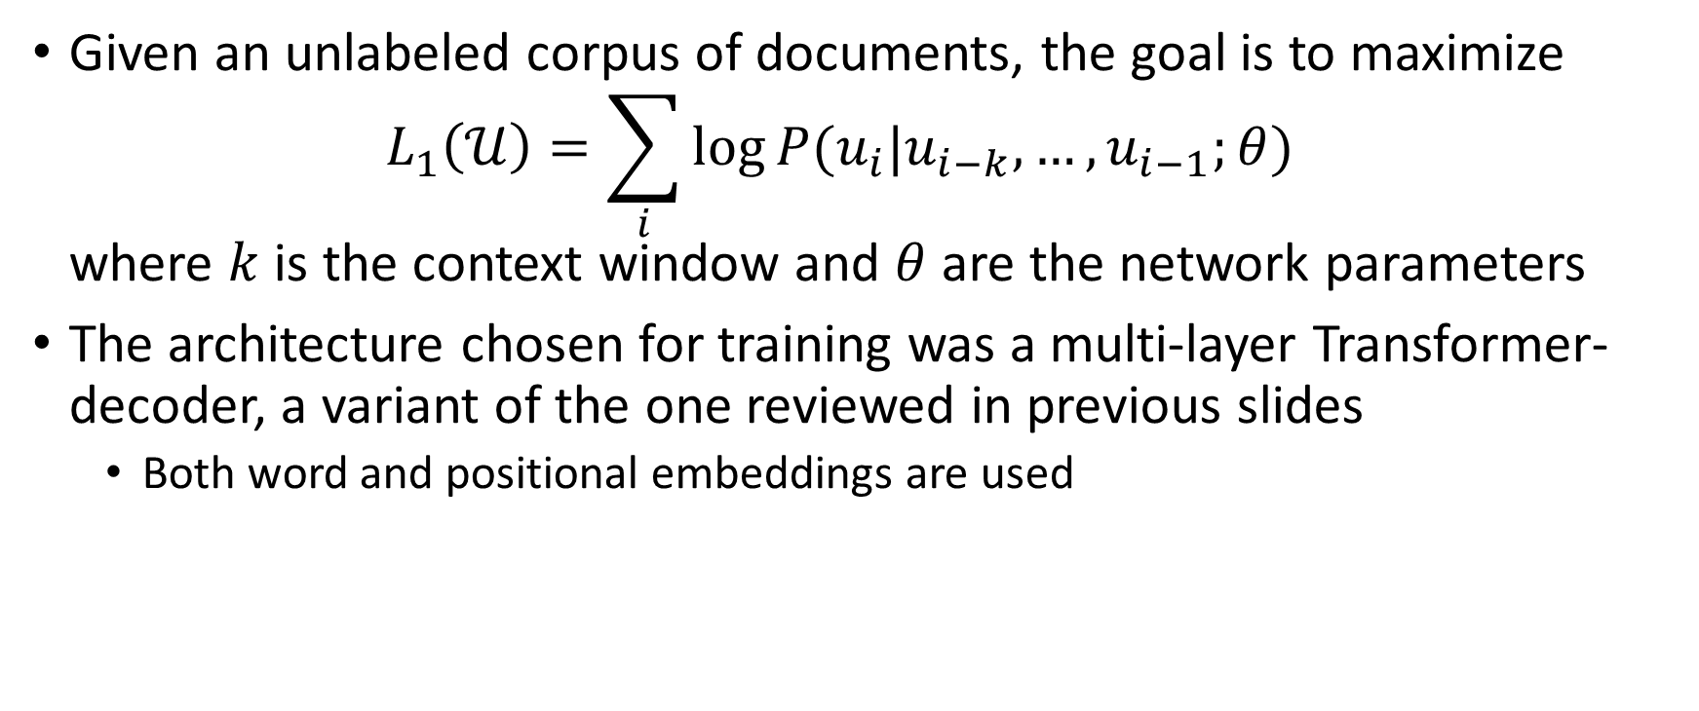
Unsupervised Pre-Training
Given an unlabeled corpus of documents, the goal is to maximize $L_{1}\left(𝒰\right)=\sum_{i}{\log{P(u_{i}|u_{i−k},…,u_{i−1};θ})}$ where $k$ is the context window and $θ$ are the network parameters
The architecture chosen for training was a multi-layer Transformer-decoder, a variant of the one reviewed in previous slides
Both word and positional embeddings are used

Slide 24
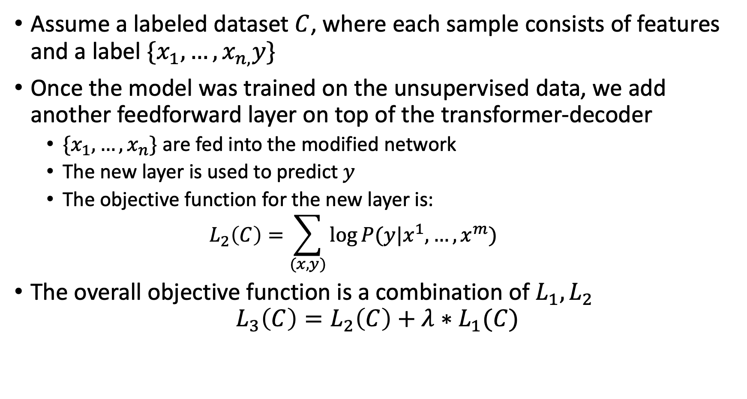
Supervised Fine-Tuning
Assume a labeled dataset $C$, where each sample consists of features and a label $\{x_{1},…,x_{n,}y\}$
Once the model was trained on the unsupervised data, we add another feedforward layer on top of the transformer-decoder
$\{x_{1},…,x_{n}\}$ are fed into the modified network
The new layer is used to predict $y$
The objective function for the new layer is: $L_{2}\left(C\right)=\sum_{(x,y)}{\log{P(y|x^{1},…,x^{m})}}$
The overall objective function is a combination of $L_{1},L_{2}$ $L_{3}\left(C\right)=L_{2}\left(C\right)+λ∗L_{1}(C)$
Notes:
$x^{1},…,x^{m}$ - because this is the output of the transformer-decoder and not the original input

Slide 25
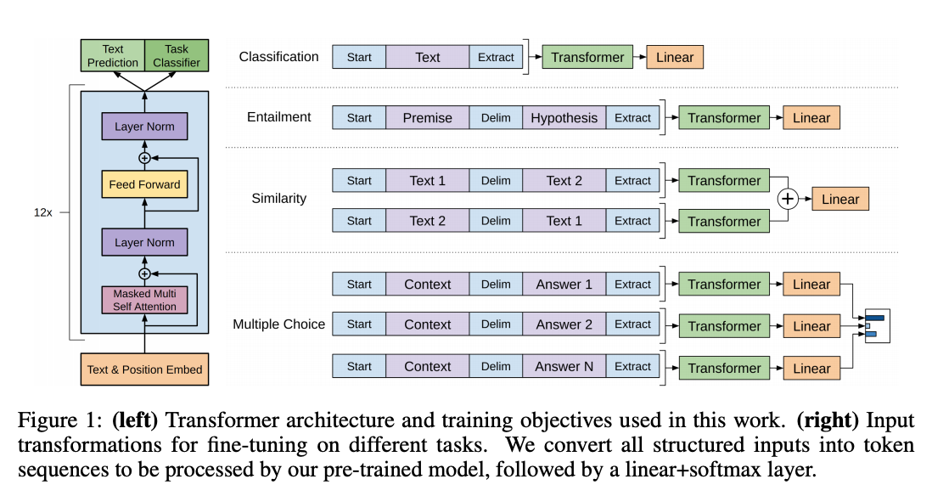
Generative Pre-Training

Slide 26
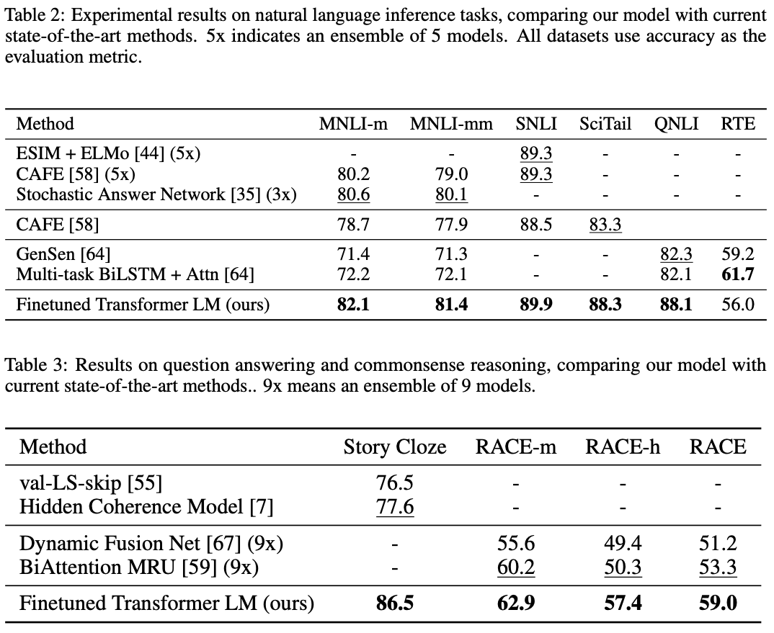
Generative Pre-Training – Results

Slide 27
State-of-the-art Work
Significant progress has been made in the field of natural language processing (NLP) in the 2-3 recent years.
We next review four high-impact studies:
The Transformer (tensor2tensor)
OpenAI GPT
ELMo
BERT

Slide 28
BERT: Bidirectional Encoder Representation from Transformers
Currently (as of the time of this slide) the state-of-the-art in the field
Builds upon both the Transformer work and GPT
The model has the following characteristics:
Bidirectional
Deep – multiple layers of transformers
Pre-training a general model using two tasks
Embedding both for segment and token
The paper presents two versions of the architecture:
BERT-Base: 12-layer, 768-hidden-nodes, 12-attention-heads, 110M parameters (same number of params as GPT, a deliberate choice)
BERT-Large: 24-layer, 1024-hidden-nodes, 16-attention-heads, 340M parameters
Notes:
A Transformer works by performing a small, constant number of steps. In each step, it applies an attention mechanism to understand relationships between all words in a sentence, regardless of their respective position.

Slide 29
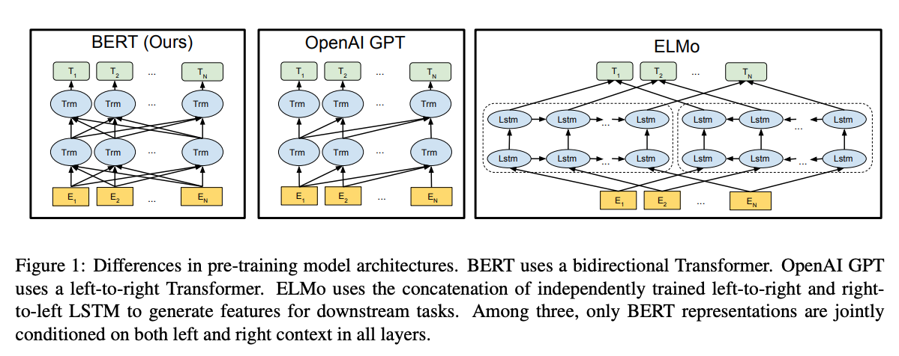
BERT Architecture
Notes:
Since BERT’s goal is to generate the encoding, it only needs the encoding part.

Slide 30
BERT Pre-Training
BERT’s input consists of two sentences
Relevant for multiple scenarios that require pairs: question/answer, translation etc.
Rather than train specifically per task, BERT is trained on two general problems:
Masked language model (LM)
Next Sentence prediction (two consecutive sentence, swapped 50% of the time)

Slide 31
Masked LM
The task: for each sequence of tokens, randomly mask 15% and attempt to predict them
Because the model is bidirectional, no use in predicting the final terms
When a token is chosen for replacement:
80% – replace the token with [MASK]
10% – replace token with random word
10% – do nothing
Notes:
By replacing with a random word, the model does not try to predict it, but it forces the model to be more robust. The “do nothing” setting is designed to bias the model towards the observed word.

Slide 32
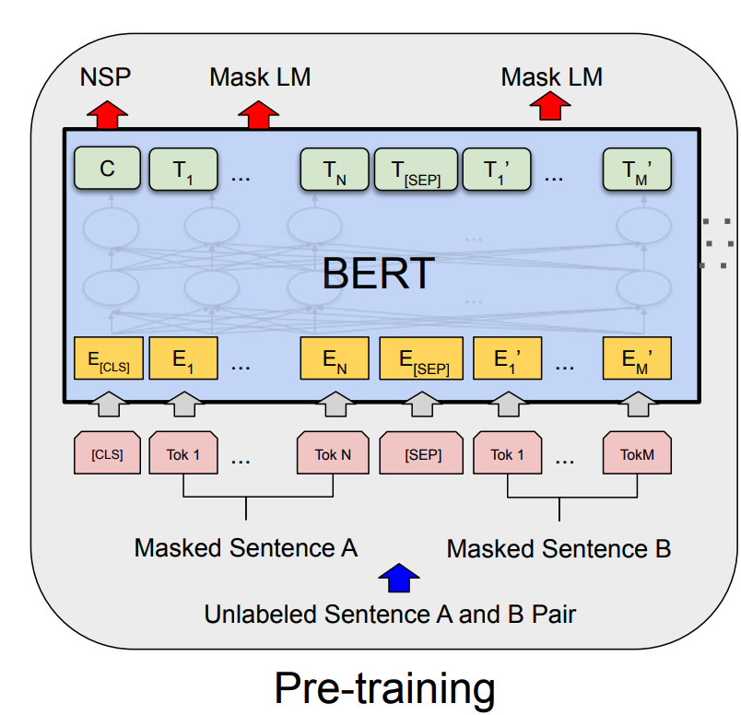
BERT Pre-Training
Does the next sentence follow the first?
Token reconstruction

Slide 33
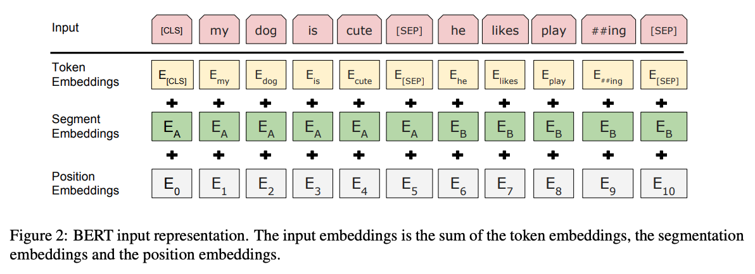
BERT Embedding
Token embeddings: A [CLS] token is added to the input word tokens at the beginning of the first sentence and a [SEP] token is inserted at the end of each sentence.
Segment embeddings: A marker indicating Sentence A or Sentence B is added to each token. This allows the encoder to distinguish between sentences.
Positional embeddings: A positional embedding is added to each token to indicate its position in the sentence.

Slide 34
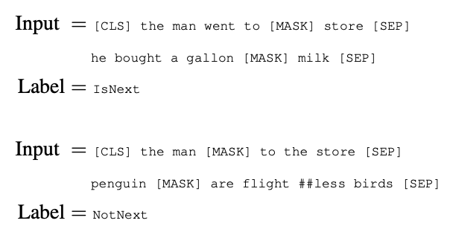
Next Sentence Prediction
BERT is trained on a binary classification task whose goal is to determine whether the given sentence will appear next
While the test is easy (~98% success rate) incorporating this task improved the model’s performance on multiple tasks

Slide 35
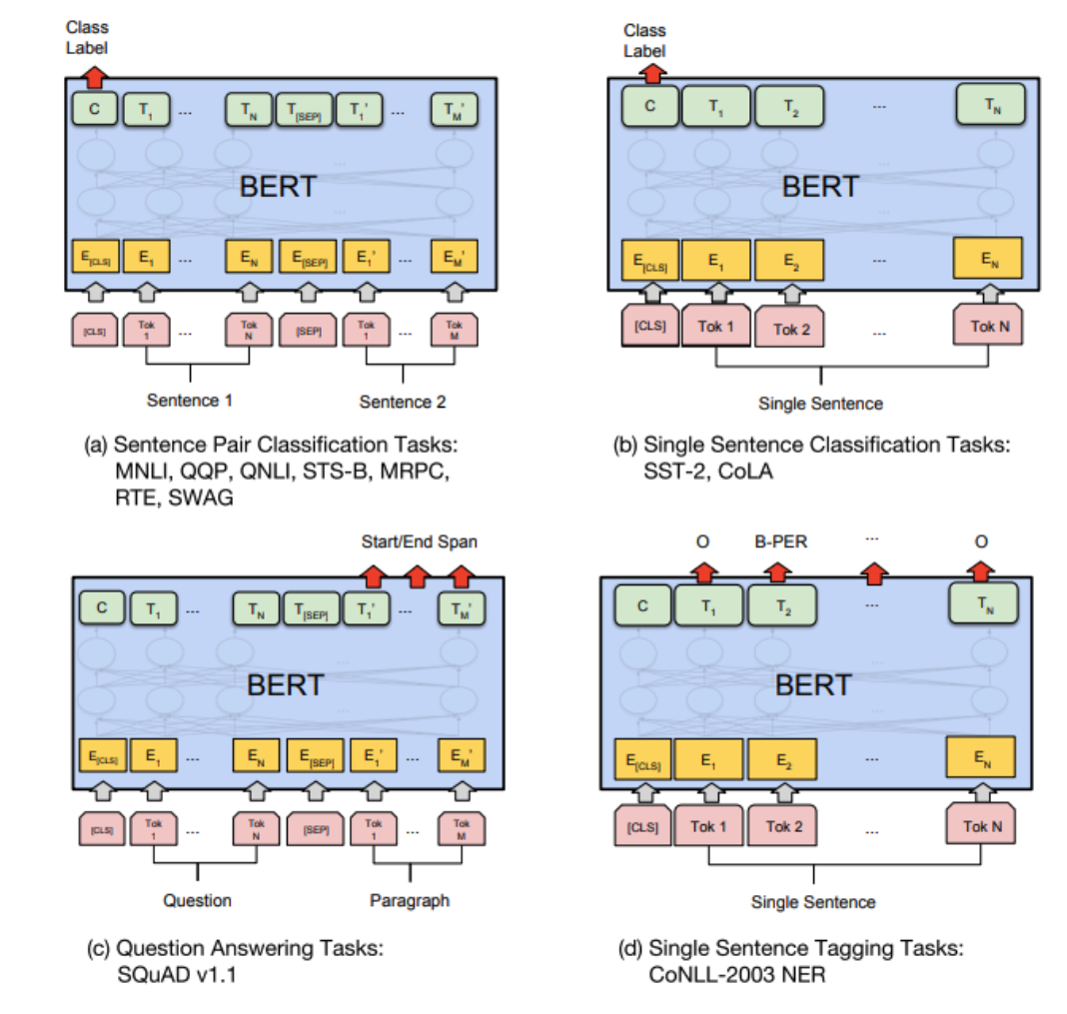
Task-Specific BERT Models

Slide 36
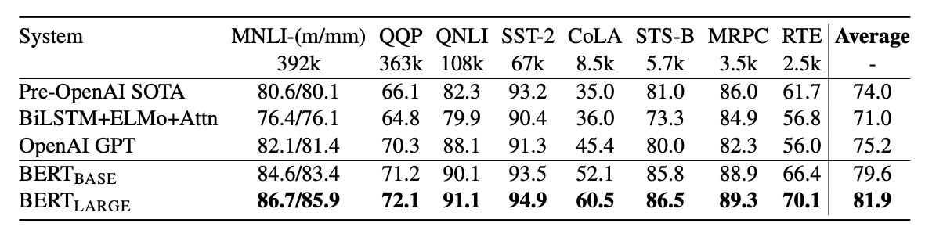
BERT – Results

Slide 37
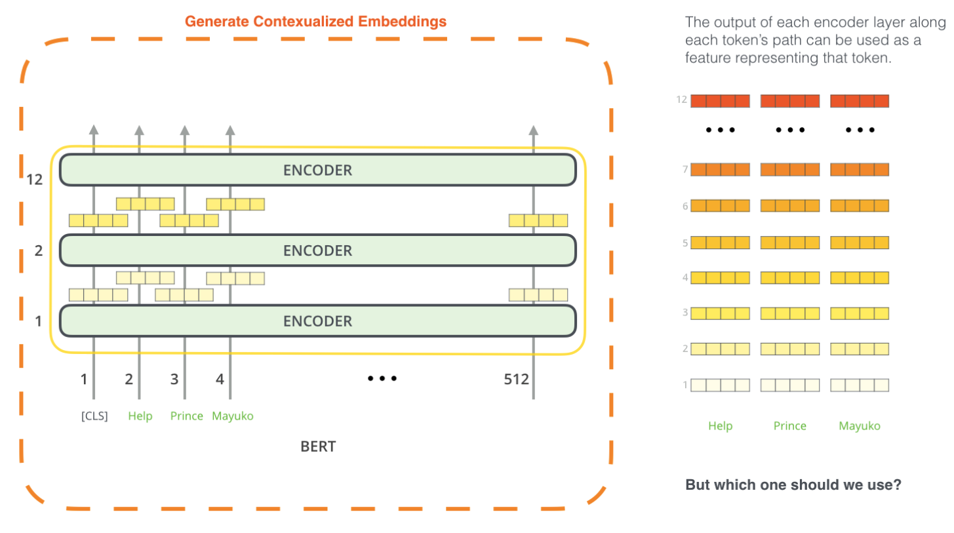
Using BERT to Generate Features
http://jalammar.github.io/illustrated-bert/

Slide 38
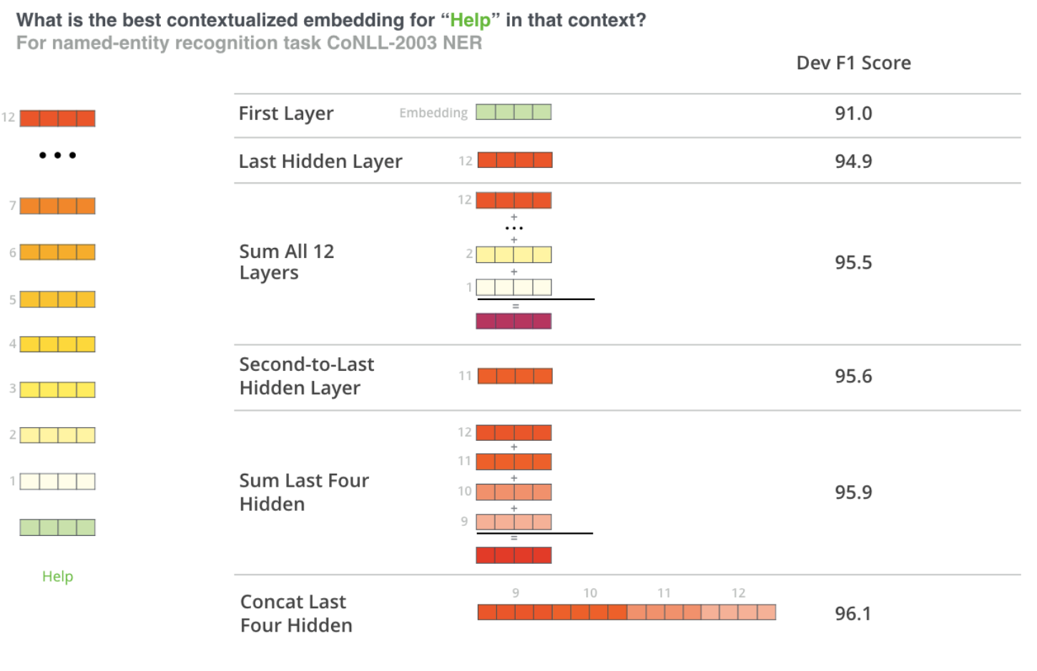
Using BERT to Generate Features

Slide 39
The Vision Transformer
An Image is Worth 16x16 Words: Transformers for Image Recognition at Scale

Slide 40
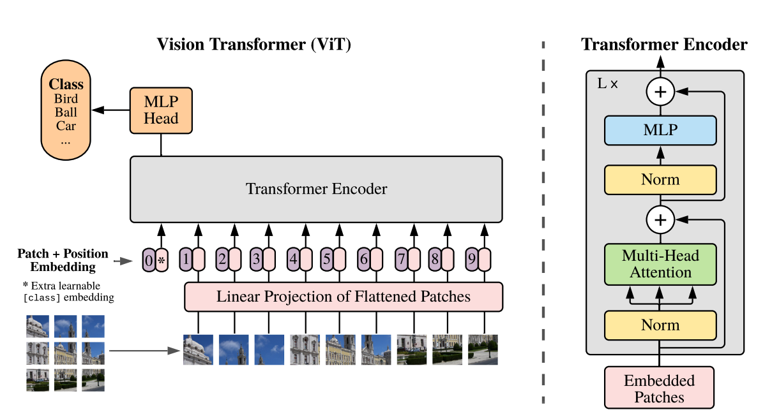
The Vision Transformer

Slide 41
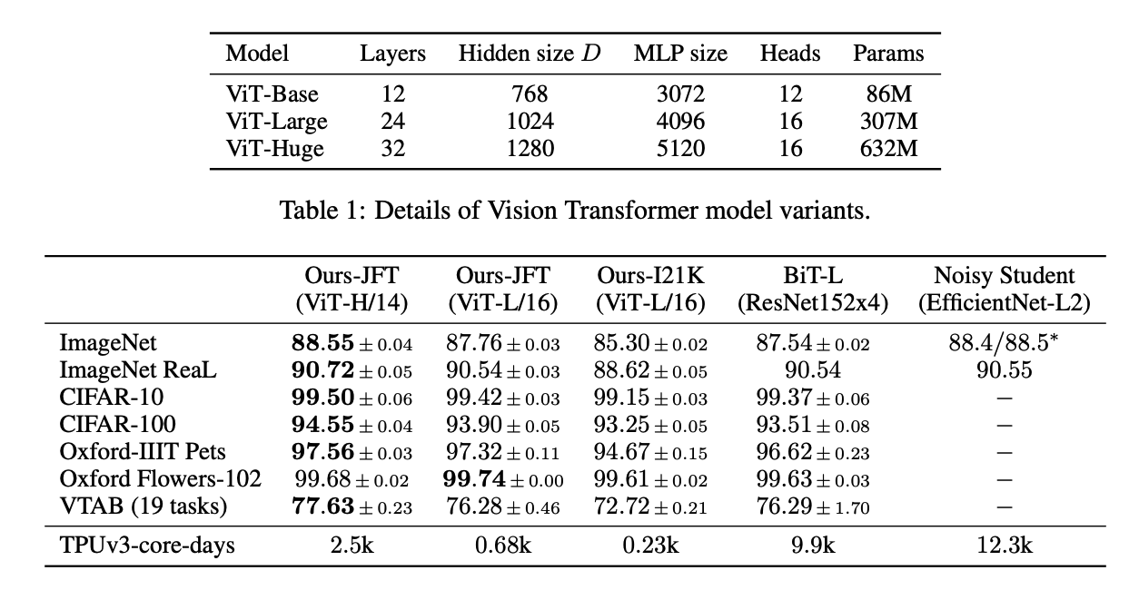
The Vision Transformer

Slide 42
